Slide 1
GLOBAL TEMPRATURE CHANGE 1850-2016 (model)
Volgenau School of Engineering
STAT-515 (Spring 2019)
Prof: Pramita Bagchi
Navy Merianda
Garima Oswal
Ahmed Mahfouz
Vivian Pakalapati
Volgenau School of Engineering
STAT-515 (Spring 2019)
Prof: Pramita Bagchi
Navy Merianda
Garima Oswal
Ahmed Mahfouz

Slide 2

AGENDA
Redesign project dataset and visuals recap
NASA forcings in GISS Climate Models CMIP dataset
Combining Hadcrut4 and CMIP datasets
Visualizing the combined dataset
Multiple linear regression model and variable selection
Future prediction
Conclusion
Q&A

Slide 3

Hello again!

Slide 4

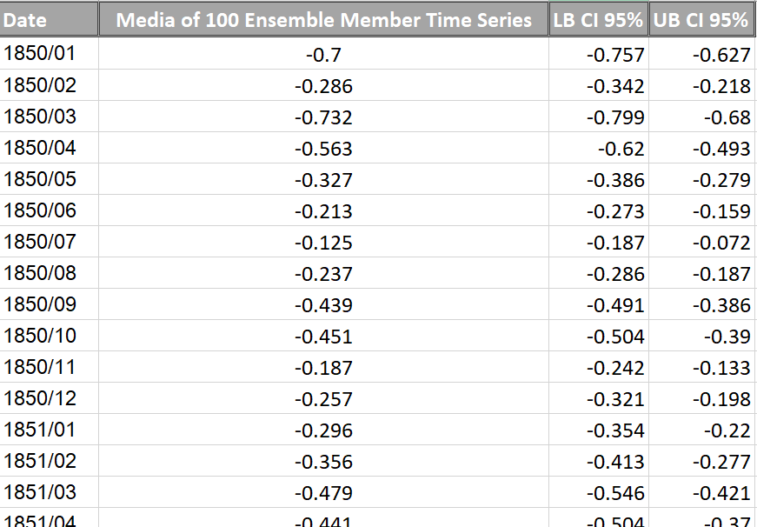
Redesign project dataset and visuals recap
HadCRUT4
HadCRUT4 is a gridded dataset of global historical surface temperature anomalies relative to a 1961-1990 reference period. Data are available for each month since January 1850, on a 5 degree grid. The dataset is a collaborative product of the Met Office Hadley Centre and the Climatic Research Unit at the University of East Anglia.

Slide 5
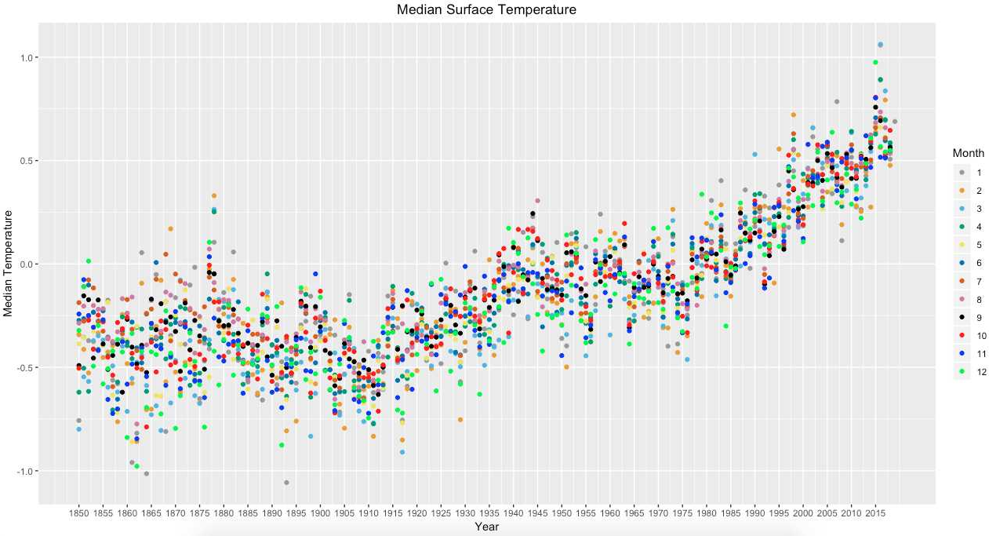
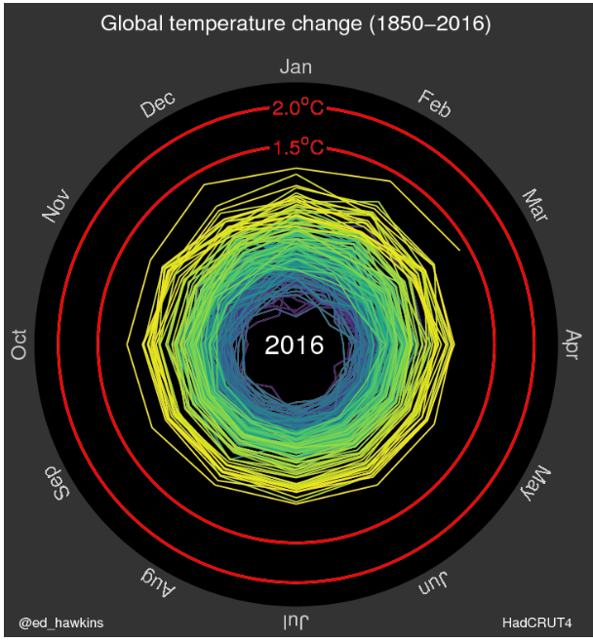
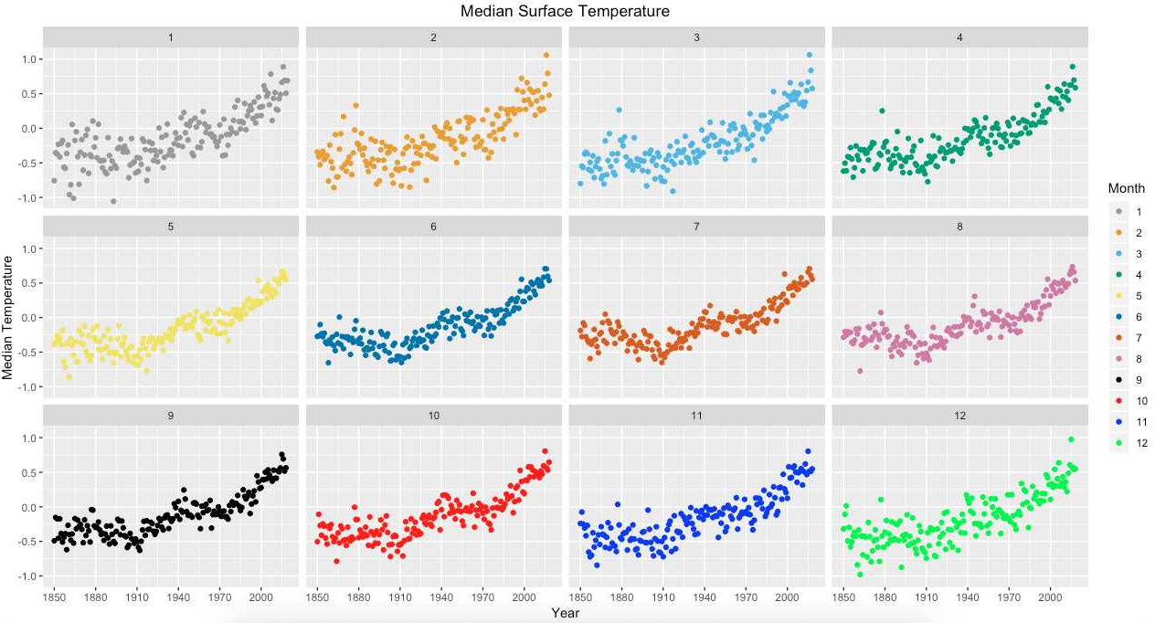
Redesign project dataset and visuals recap
Animated spiral presents global temperature change.

Slide 6


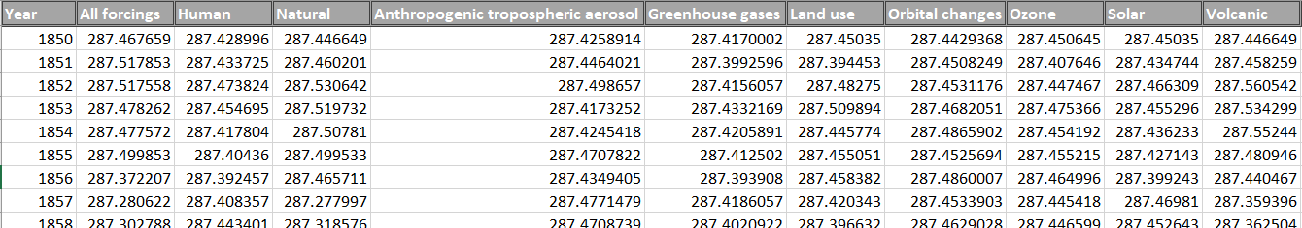
NASA Forcings in GISS Climate Models Dataset
Forcings in GISS Climate Models
Forcings can be specified in a number of different ways. Traditionally, forcings have been categorized based on specific components in the radiative transfer calculation (concentrations of greenhouse gases, aerosols, surface albedo changes, solar irradiance, etc.). More recently, attribution of forcings have been made via specific emissions (which may have impacts on multiple atmospheric components) or by processes (such as deforestation) that impact multiple terms at once (e.g., Shindell et al., 2009).
CMIP5 GISS-E2 Global Radiative Forcings (Fi) Miller et al (2014)
The objective of the Coupled Model Intercomparison Project (CMIP) is to better understand past, present and future climate changes arising from natural, unforced variability or in response to changes in radiative forcing in a multi-model context.

Slide 7

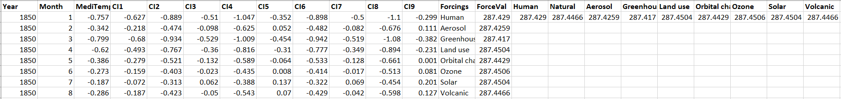
Combing Hadcrut4 and NASA datasets
We have combined the data from the CMIP5 and HadCRUT4 and produced one single gridded data that we used for building our model and aggregated visualizations.

Slide 8
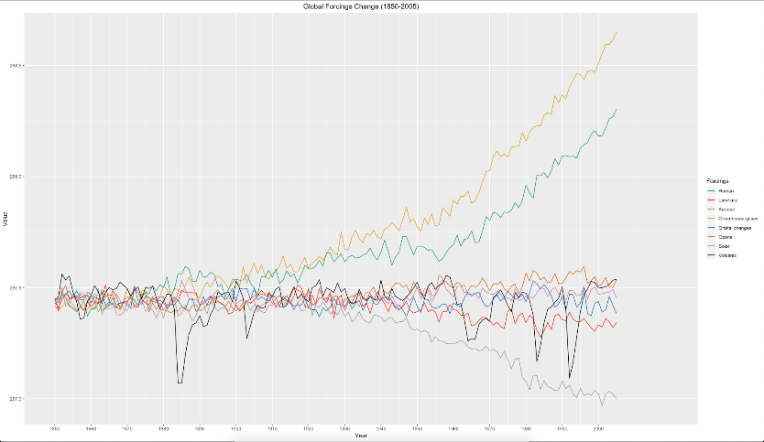
Visualizing the combined dataset
Aggregated visualizations
This is a line plot which shows the increase in values of various forcings
through the years.

Slide 9
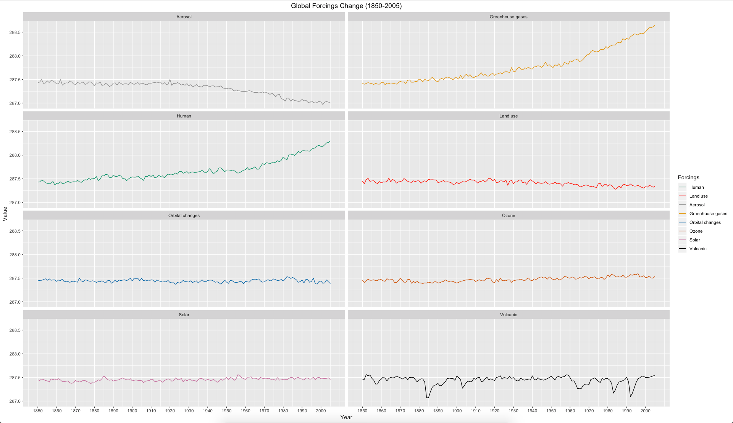

Aggregated visualizations
Individual plot for each of the forcings through the years:

Slide 10
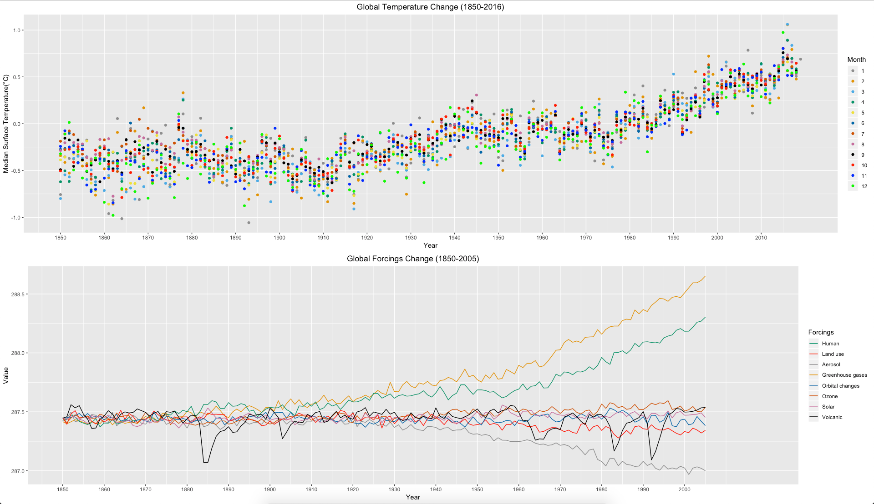

Aggregated visualizations
Greenhouse gases, seems the most influential factors amongst them.

Slide 11

Multiple linear regression model and variable selection
0
Questions wanted to answer:
Is there any relationship between the different forcings and the climate temperature increase?
Which forcing has a strong relationship and is an important variable to predict the Climate Temperature increase?
How accurate our estimated model for prediction?

Slide 12
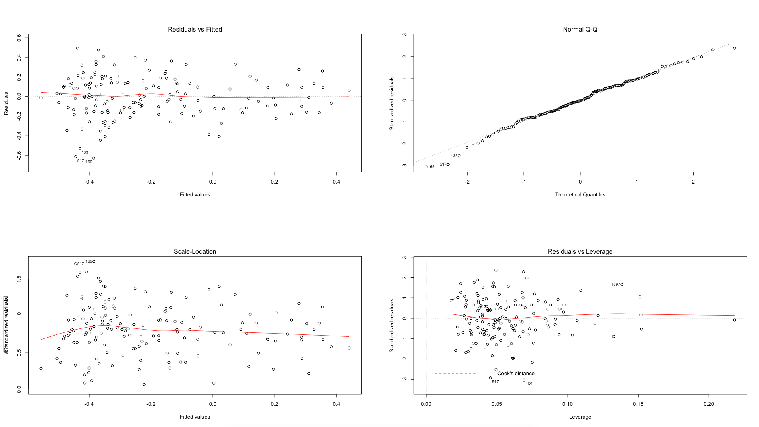

Multiple linear regression model and variable selection
0
Is there any relationship between the different forcings and the climate temperature increase?
Looking at the diagnostics plot for a multiple linear regression model for all the variables. It seems like there is a linear relationship it’s not just a random data.

Slide 13
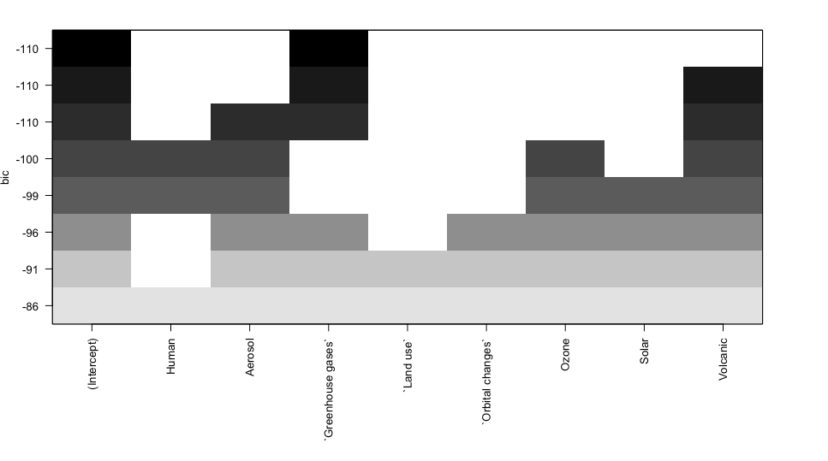
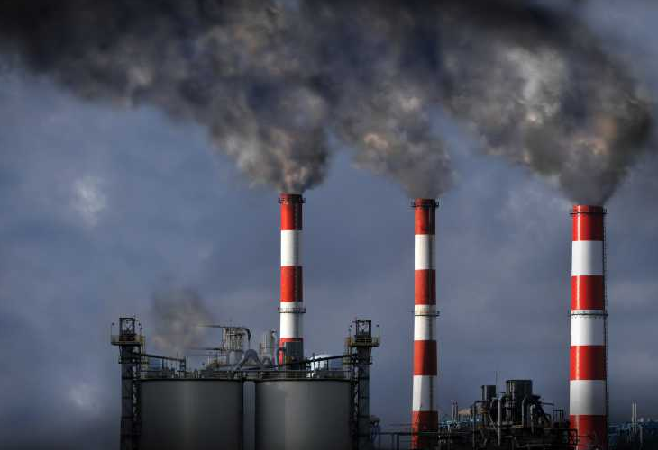
Multiple linear regression model and variable selection
0
Which forcing has a strong relationship and is an important variable to predict the Climate Temperature increase?
After doing a subset selection, the BIC (Bayesian Information Criterion) has a minimum at 1 variable. The BIC is often chosen the preferred model selection criterion.
Greenhouse gases is the most significant variable and the best variable to build our model and make predictions.

Slide 14
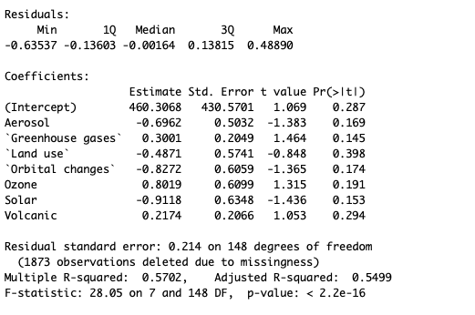
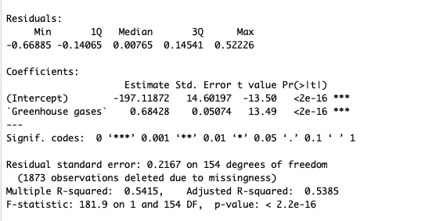
Multiple linear regression model and variable selection
0
How accurate our estimated model for prediction?

Slide 15
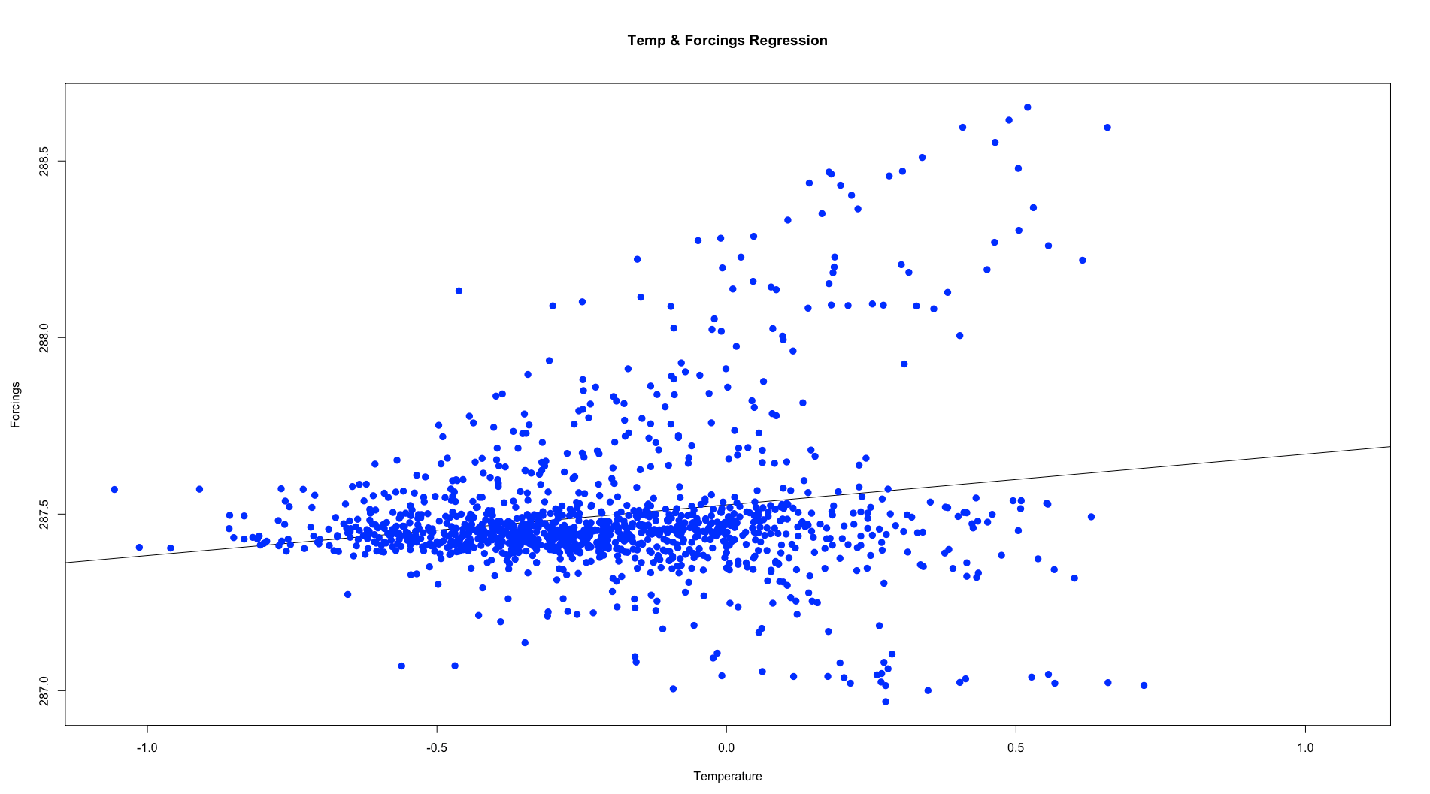
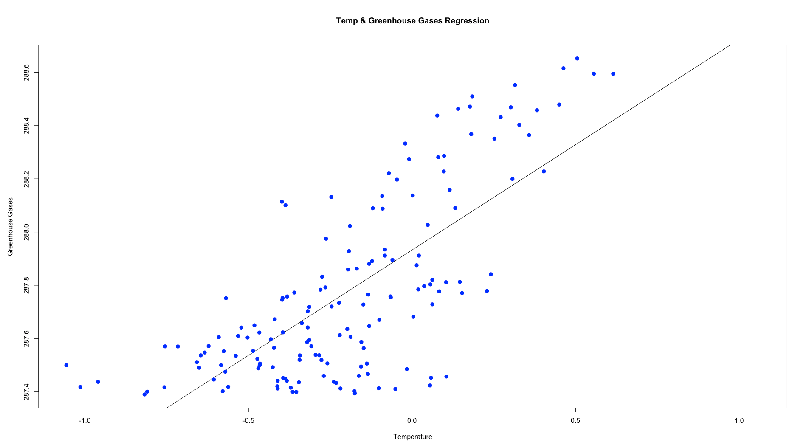
FUTURE PREDICTIONS
0
Now we have built our mode it’s time to do some regression and predict the climate temperature increase by 2030.
1.322253 C
1.5° Climate Temperature increase is fast approaching. The current WMO report shows with the current rate of emissions, the world will reach 1.5°warming by between 2030 and 2052.

Slide 16
CONCLUSION
0
Building the right data visualization plots help understanding and examining the data visually with better insights before constructing your model.
The linear model diagnostics plot helped us to examine the relationship between the climate forcings and the temperature and led us to the conclusion that there is a linear relationship.
Variable selection is a key element for building an efficient model and helps focusing on the right variables and reduces the complexity of the final model.
R is a very powerful language with a an excellent and extensive tools to help build a better data visualization and predictive models.

Slide 17

Thank you!
Q&A

